Slide 1
GOMC Capstone
Client: Younes Nejahi
By: Muamer Besic
Caleb Latimer
Ahmed Taher

Slide 2
Presentation Overview
Ahmed
Intro, Overview, Conflict Resolution
Moe
Project Plan, Team Organization
Caleb
Project Scope, Technologies

Slide 3
Project Overview
GOMC stands for GPU Optimized Monte Carlo simulation engine
Website currently static, forcing manual maintenance
Downloads page requires manual upkeep
Users are prone to input errors
Solution = Dynamic website
Notes:
Link to short demo of Monte Carlo Simulation https://www.youtube.com/watch?v=QD1GKLpP9W8

Slide 4
Project Scope
Designing and implementing new website
Integrate github api for automated announcements and updates
User input -> XML
Modify project

Slide 5
Team Organization
UI/Front-End Lead: Caleb Latimer
Database/Back-End / Team Lead: Ahmed Taher
Documentation Lead: Muamer Besic
QA Lead - Caleb Latimer
Presentation Lead: Muamer Besic

Slide 6
Project Plan
Client Meetings
Every Wednesday 2p
TA Meetings
Every Thursday 3p

Slide 7
Project Plan
Requirements Meeting 9/20
Tech -Stack
Mockup/Wireframe
Research Sites
Discuss requirement prototype
Requirement Approval Meeting 9/27
Approve and review requirements
Present stack design scheme
Finalize development plan
Receive faculty feedback on wireframes and mockups

Slide 8
Project Plan
Prototype 1 Rev 10/4
Have code review for first master merge
Have TA critique design
Have code standards rbc
Have Style guide rbc
Prototype 1 rev 2 10/11
Have prototype 1 merged, tested and approved
Present and discuss DFD for api
Discuss design scheme for admin page
Design Specs 10/18
TBD

Slide 9
Problem Resolution Policies
Verbal warning from the group
Rest of team will have to make up the work not done
Written communication
Inform the professor
Professor’s decision

Slide 10
Tech
Config mgmt
Github repository
Stack
ASP .Net , Razor, Pure.css, jQuery
C#, Github Api V3, JSON
C/C++, CMake
MySQL

Slide 11
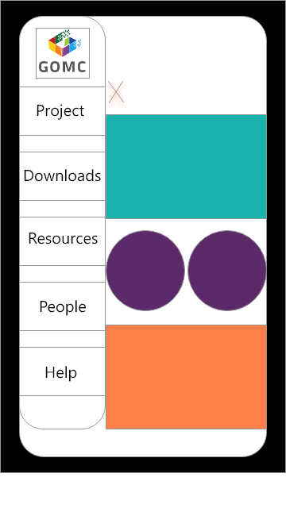

Mobile Wire frames

Slide 12
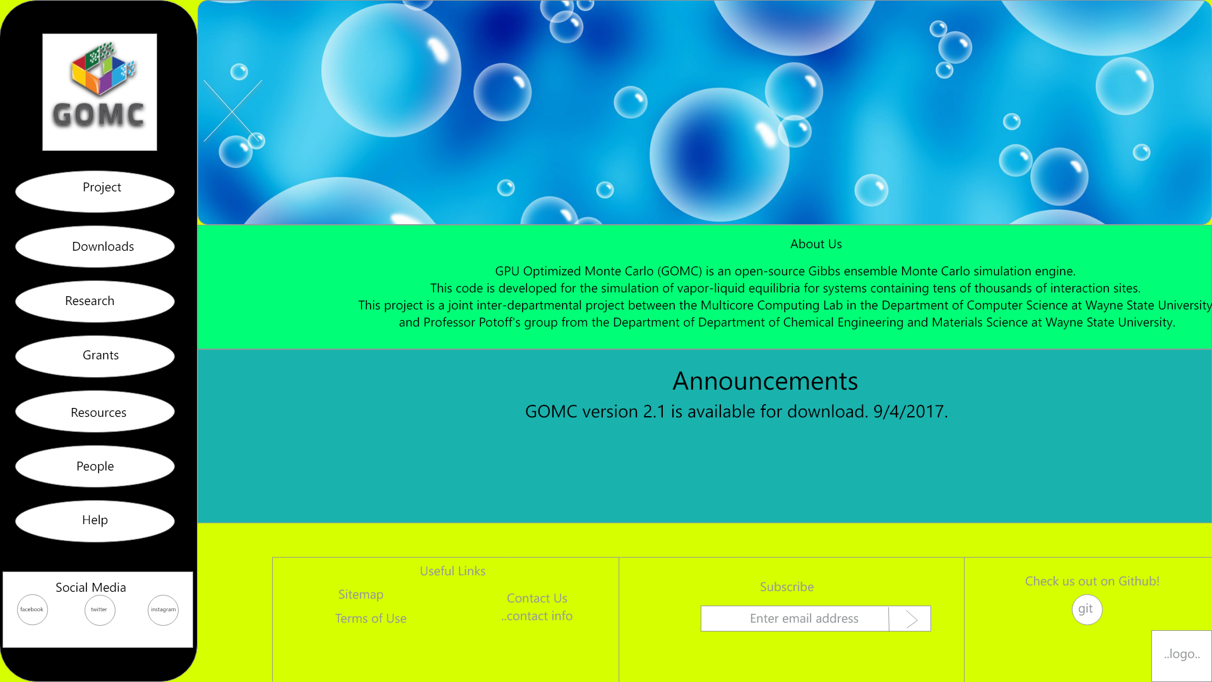
Desktop Mockup

Slide 13
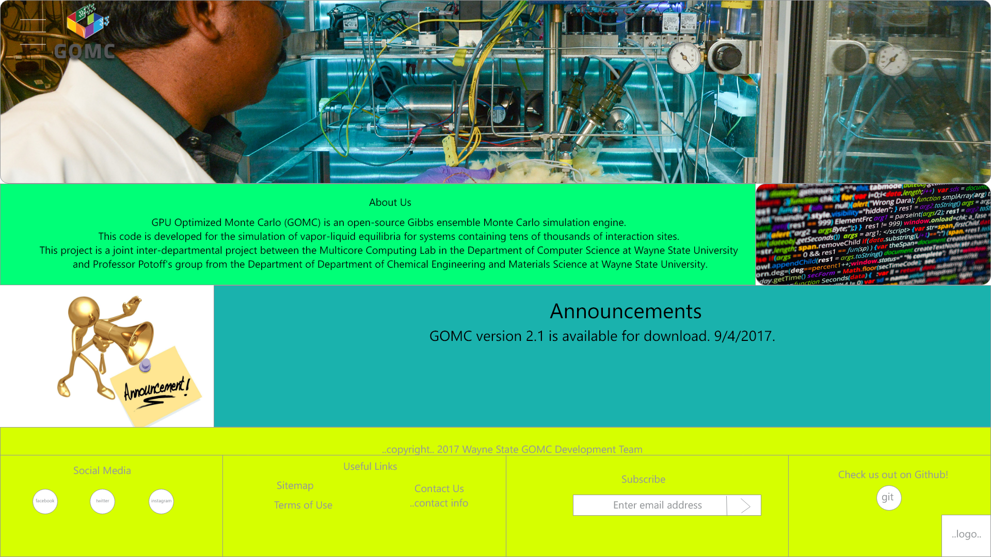
Desktop Mockup menu closed

Slide 14
Next steps
Build out and have TA review Requirements doc
Build out 2 more additional mockups for client to have feedback with more design options
Draft requirements presentation

Slide 15
Questions?

